Slide 1


AeroInsight Visualizing Aviation Data
Visualizing aviation data to uncover facts, trends, and insights within the industry
Submitted By : Debabrata Mishra

Slide 2
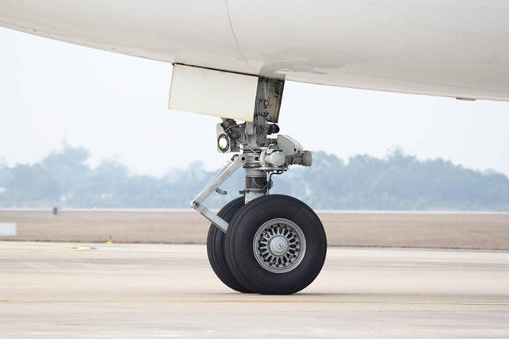
Overview
This aviation data visualization study aims to share comprehensive insights into airline safety, performance, and economic impact through meticulous analysis and presentation of diverse aviation datasets.
By leveraging reputable sources and upholding ethical data standards, we have crafted insightful visualizations.

Slide 3



Dataset Information
Aviation Safety Network
Airlines.org
Accidents and Fatalities Dataset
Contains data for 56 airlines including accidents, incidents and fatalities
Provided data on sales, geographic and economic impact
Extracted year-wise data on accidents and fatalities
The visualizations leverage diverse datasets from reputable sources to present a comprehensive view of aviation data.

Slide 4
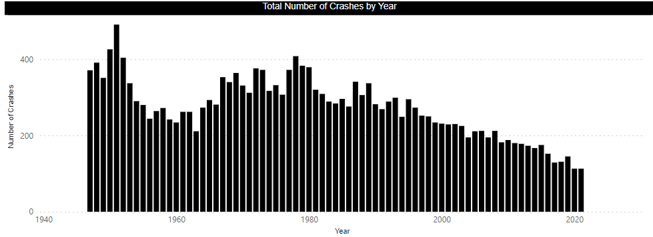






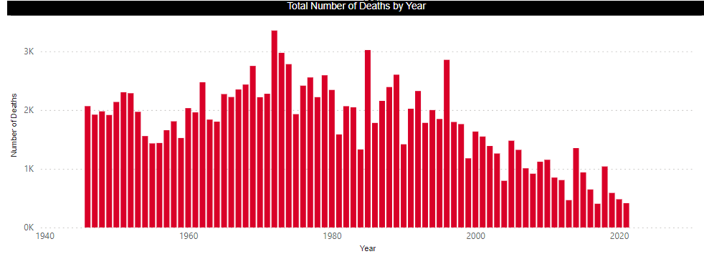
Yearly Aviation Deaths and Plane Crashes
1985 - 1999
2000 onwards
Over time
Avianca had major accidents
Kenya Airways shifting safety stats
Few airlines show correlation
2000 - 2014
Both periods
PIA, Ethiopian
Avianca safety improved
China Airlines faced fatalities
High incident rates persist
Over the past decade, the aviation industry has seen a gradual decline in the number of accidents and fatalities, illustrating an overall improvement in safety standards. While there are periodic variations, the consistent downtrend underscores the impact of enhanced safety protocols and technologies, especially in economically and technologically advanced nations. Additionally, the concentration of safety incidents tends to be higher in regions with dense air traffic and complex airspace configurations, highlighting areas where further safety measures could be targeted.

Slide 5
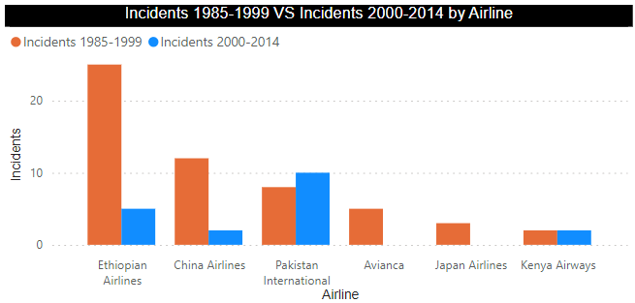
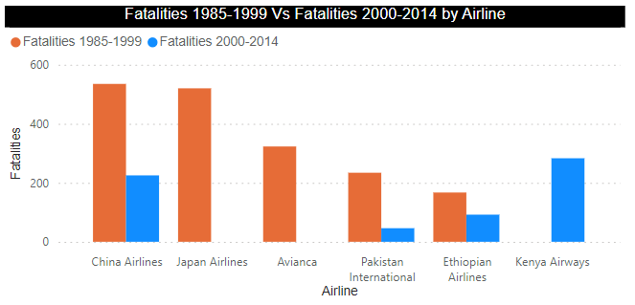
Top 6 Airlines with overall most incidents
Fatalities:
From the correlation of airlines and timeframe, Fatalities across airlines and timeframes show variations. Avianca had major accidents in '85-'99 but improved after that. Kenya Airways exhibits shifting safety stats, while China Airlines faced fatalities in both periods, signaling ongoing challenges
Incidents:
In terms of incidents, few airlines demonstrate a consistent correlation between the two timeframes. While most show signs of improvement, outliers like PIA and Ethiopian persist with persistently high incident rates, requiring targeted safety measures.

Slide 6
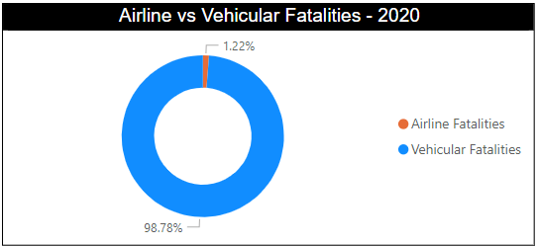
Road Travel vs Air Travel Comparison
From the perspective of passenger usage, airplanes are the sixth most utilized mode of transportation, while cars are in second place. Comparative analysis between global flight incident data and U.S. road incident statistics reveals that the average annual fatalities from car accidents are 129 times higher than those from airline incidents. Looking at the periods from 1985-1999 to 2000-2014, there is a noticeable decline in total fatalities for both transportation modes, indicating improved safety over time.

Slide 7
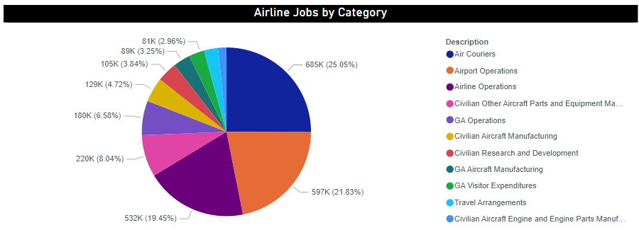
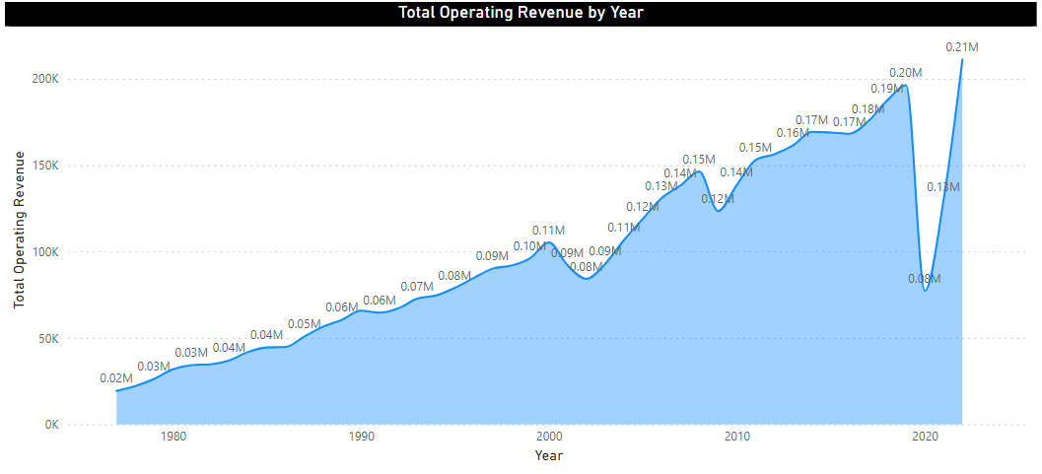
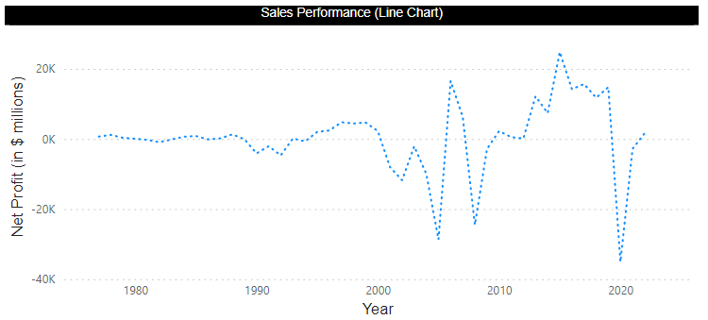
Airline
Economic Impact

Slide 8
Insights and Observations
Safety Trends
Statistical Data & Decisioning
Decreasing Accidents and Fatalities
Varying Safety Records
Some airlines consistently maintain high safety records, with minimal incidents reported over the years.
Over the past decade, there has been a gradual decrease in the number of accidents and fatalities in the aviation industry.
Significant Economic Impact
Seasonal Variations
States with major aviation hubs contribute significantly to the economy, generating billions of dollars in revenue and supporting thousands of jobs.
Seasonal variations and promotional campaigns can also influence ticket sales, contributing to the dynamic nature of the aviation market.
Technology Innovations
Enhanced Security
The AeroInsight dashboard provides a comprehensive, ethics-driven analysis of aviation data, facilitating the identification of safety trends and performance indicators. By fostering transparency and an informed interpretation of insights, this tool can empower stakeholders across the aviation industry to make data-driven strategic decisions.

Slide 9

Questions?
If you have any other questions about the airline industry findings from our analysis, please feel free to reach out. We are happy to provide any clarification or additional details as needed.

